Slide 1
The Effect of Sexual Orientation on the Demand for Children
Jude Bashto
Framework:
Family composed of person A and person B
Person A: $14/ hour Person B: $50/hour
Minimum $5,000 to live
Person A: 357 hours of work to live Person B: 100 hours of work to live
Person A: Higher opportunity cost Person B: Comparative Advantage in producing
Income
Notes:
Today I will be presenting on The Effect of Sexual Orientation on the Demand for Children
First, I’m gonna propose a framework for us to work with
Consider a family composed of person A and person B
The basic idea here is that person B makes more money than person A, so they have the comparative advantage in getting market income
I will be distinguishing between both in my analysis
the main thing is that spouse B focuses on labour income, but spouse A focuses on household production

Slide 2
Research question: What is the impact of sexual orientation on the demand for children?
Expected answer(s) to research question:
For every income level, same-sex couples will have a lower quantity demanded for children than opposite-sex couples. why? >This is due to biological constraints as well as additional adoption financial constraints > Children are more ‘expensive’ to same-sex couples.
The differentials in number of children between same sex and opposite sex couples will: a) Increase as the income of the higher income spouse increases why? > Assuming children are a normal good, an increase in their income means that both couples can afford more
children. However, children are more expensive for same-sex couples. So the marginal increase in children is less for
same-sex couples.
b) Decrease as the income of the lower income spouse increases
why? >Assuming that the homemaker has a choice between market income and children, and that opposite sex couples are more efficient in producing children (but not income), differentials decrease as homemakers substitute away from children into income.
Notes:
Moving onto my research question.
So my question is “What is the impact of sexual orientation on the demand for children”
And the expected answer to this is: First of all, same sex couples will have a lower quantity demanded for children than opposite-sex couples
and we can say that the marginal cost of having a child is higher for same sex couples.
I will also claim that: The differentials in number of children between same sex and opposite sex couples will increase as the income of the higher income spouse increases. This is because, if we consider two couples that are same-sex and opposite-sex and are identical in all other aspects, we expect the marginal child to be more expensive for the same sex couple. So if both couples got an increase in income for the higher income spouse, it will have a pure income effect, but the opposite sex couple will be able to afford more children with this additional income. Therefore, the differentials will increase.
Lastly, I will predict that the differentials between same sex and opposite sex couples will decrease as the income of the lower income spouse increases.
remember that, by definition, my model assumes that the higher income spouse only engages in the labour market but the lower income spouse can choose to do both
if the lower income spouses’s income increases, it means that they are substituting away from children into income.
in that case, the difference in the price of children will have less of an impact on each couple pairing’s demand for children
so differentials will not be as big for a pair of couples who prefer income over children

Slide 3
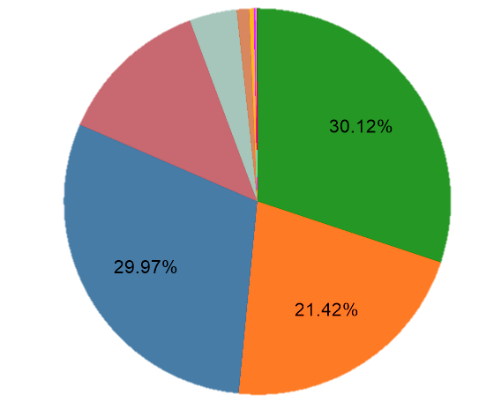
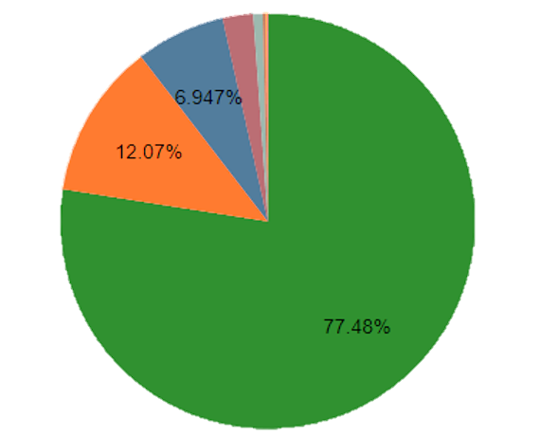
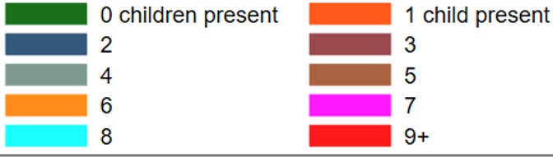


Data and Exclusions
Percentage of Respondents by Number of Children
Data Source: American Community Survey (2015-2019) inflation adjusted and pooled.
Opposite-sex couples
Same-sex couples
Exclusions from Sample
Mine: 1) Exclude Over 45 and Under 18 2) Individuals not in Households 3) Individuals not in relationships 4) Higher-income spouses 5) Individuals born abroad 6) Individuals previously married
7) Self-employed individuals
From the A.C.S:
Group quarter types:
1) Domestic Violence Shelters 2) Soup Kitchens 3) Maritime Vets ,….etc.
Opposite- Sex Couples:
Same- Sex Couples:
Pseudo-random sampling from sample: 200,000 respondents from opposite sex couples All respondents from same-sex couples
Total sample: 215,144 Same sex: 15,444 Opposite sex: 200,000
Same-sex over-represented
Notes:
So the data used for my paper is from the american community survey from 2015 to 2019
there are two kinds of sample restrictions here: mine and the ACS ones
{{{{ SKIP}}}}: ‘all of my restrictions are justified in the paper, but we don’t have time here, the main thing is that i only kept respondents who make less money than their spouses’
First restriction is an age restriction customary in children studies
Second restriction is the household restriction, we just exclude all non-household addresses.
Third restriction excludes individuals not in relationships. this is because in the data we cant know sexual orientation for single people.
Fourth restriction excludes respondents who are the higher income earning spouse. This is because I want to examine only the lower income earning spouse.
Fifth restriction excludes individuals born abroad because this may introduce country-specific factors and unobserved heterogeneity that I can’t account for in my model.
Sixth restriction excludes individuals previously married just in case there are individuals currently in a same sex relationship who had kids in a previous opposite sex relationship
Last restriction excludes self-employed individuals because business or farm income can complicate the relationship between income and number of children }}}}
After all the restrictions, i took a smaller sample from opposite sex couples and dropped the rest,
so same sex couples are over-represented.
I then decided to split my sample in two by sexual orientation, and i got this pie chart
Basically, this shows that a higher percentage of same sex couples have no children, and they make more money on average
so this sort of supports what i was saying earlier
lets test it empirically

Slide 4
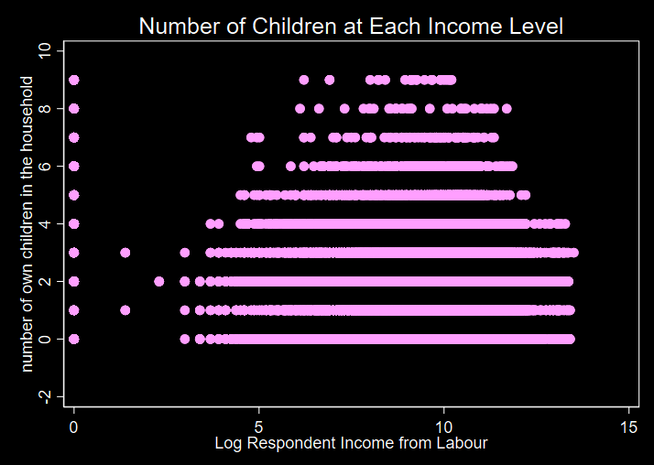


Empirical Model
Maximum likelihood estimation
Tobit Model
why? > Lower bound dependent variable
$${NChildren}_{i}= \\ β_{0}+β_{1}log{IncW}_{i}+β_{2}log{IncInv}_{i}+β_{3}{logIncWelf}_{i}+β_{4}{logIncSP}_{i}+β_{5}{SO}_{i}+β_{6}{\left(SO×logIncW \right)}_{i}+β_{7}{\left(SO×logIncInv \right)}_{i}+β_{8}\left(SO×logIncWelf \right)+β_{9}{\left(SO×logIncSP \right)}_{i}+ β_{k}X_{i}+e_{i}$$
$logIncW$: logged respondent income from labour (wage)
$logIncInv$: logged respondent income from investment
$logIncWelf:$ logged respondent income from welfare
$logIncSP:$ logged spousal income from labour
$SO:$ sexual orientation dummy, =1 if same-sex.
X: vector of control variables: Age, age squared, spouse age, spouse age squared, years of education, spouse years of education, sample year, marital status, race of respondent, hispanic ethnicity, health insurance, birthplace (state), spouse birthplace (state), state of residence, sex, highest degree attained.
What am i expecting?
Negative value for $β_{5}$
Positive value for $β_{4}$
Value for $β_{9}$ such that the predicted censored number of children for SO=0 and SO=1 diverges with increases spousal income.
Value for $β_{6}$ such that the predicted censored number of children for SO=0 and SO=1 diverges with increased respondent income.
Notes:
In order to estimate my model i will be using maximum likelihood estimation.
Specifically, i will be estimating a tobit model. the model is estimated with a lower bound of zero
Obviously, a count data regression model would be better in this context
Here is my model.
In this model the dependent variable is number of children,
and i’m saying that it is determined by the respondents income from labour, income from investment, income from welfare, and spousal income.
All logged
but I am also saying that it is determined by sexual orientation, and the interaction between sexual orientation and all of those variables.
so, sexual orientation has an effect on the effect of each of those explanatory variables.
And lastly, we have a vector of control variables.
what am i expecting? same as two slides ago, but empirically here. So I will be testing all of these.

Slide 5

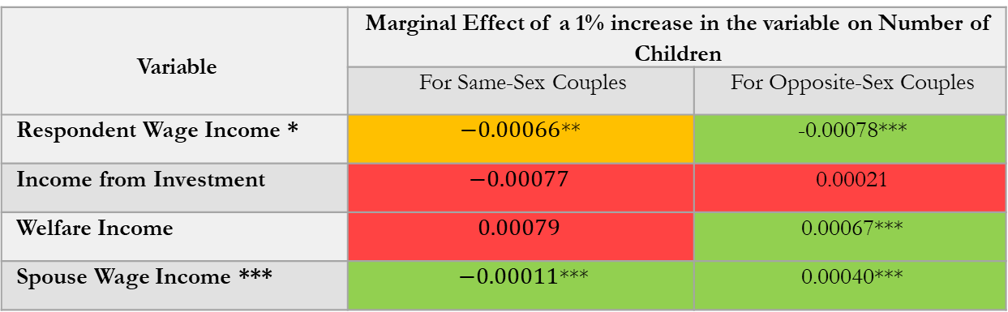
Key Regression Results:
$${\hat{NChildren}}_{i}=−8.448−0.078log{IncW}_{i}+0.021log{IncInv}_{i}+0.067logIncWelf+0.040logIncSP−0.164{SO}_{i}+0.012{\left(SO×logIncW\right)}_{i}−0.0.098\left(SO×logIncInv\right)+0.012\left(SO×logIncWelf\right)−0.0.051\left(SO×logIncSP\right)+{\hat{β}}_{k}X_{i}$$
Variable | Marginal Effect of a 1% increase in the variable on Number of Children
 | For Same-Sex Couples | For Opposite-Sex Couples
Respondent Wage Income * | $−0.00066$** | -0.00078***
Income from Investment | $$−0.00077$$ | 0.00021
Welfare Income | $$0.00079$$ | 0.00067***
Spouse Wage Income *** | $−0.00011$*** | 0.00040***
p>=0.05,* p<0.05, ** p<0.01, *** p<0.001
X: vector of control variables: Age, age squared, spouse age, spouse age squared, years of education, spouse years of education, sample year, marital status, race of respondent, hispanic ethnicity, health insurance, birthplace (state), spouse birthplace (state), state of residence, sex, highest degree attained.
Notes:
So these are the regression results
Since the income variables are all logged, so beta hats have a level-log interpretation
So right away we can see that the estimated effect of sexual orientation on number of children is negative, but not significantly. Its worrying that the effect is not significant, but oh well.
lets look at this table
Here i calculated the marginal effect of a 1% increase in the variable on number of children.
So we’re only really interested in respondent wage income and spouse wage income.
The marginal effect of a one percent increase in respondent wage income is less for same sex couples than opposite sex couples, and is negative and significant at the 1% level in both cases.
On the other hand, the marginal effect of a one percent increase in spouse wage income is less in magnitude and opposite in sign for same sex couples than opposite sex couples.
In order to be able to see if the censored number of children converge with increases in respondent income and spousal income, we need to look at the predictive margins.

Slide 6
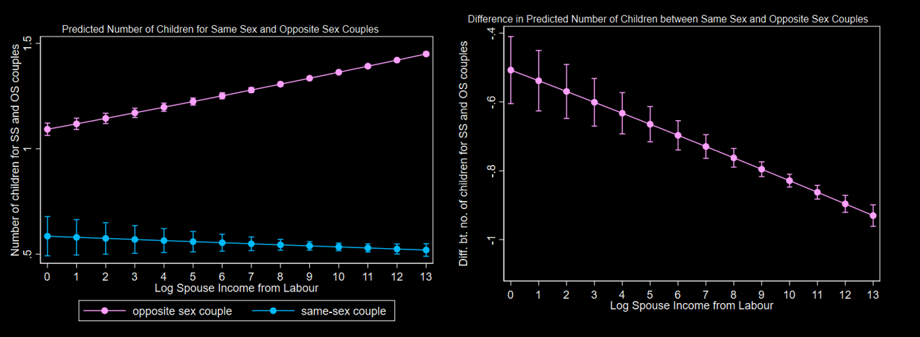
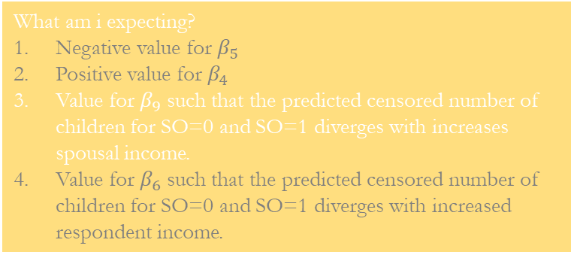
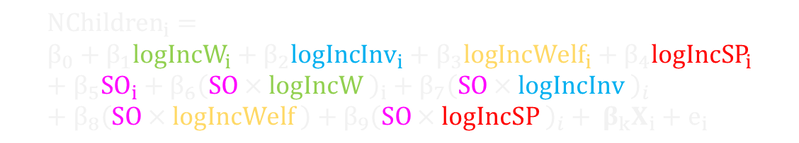
What am i expecting?
Negative value for $β_{5}$
Positive value for $β_{4}$
Value for $β_{9}$ such that the predicted censored number of children for SO=0 and SO=1 diverges with increases spousal income.
Value for $β_{6}$ such that the predicted censored number of children for SO=0 and SO=1 diverges with increased respondent income.
$${NChildren}_{i}= \\ β_{0}+β_{1}log{IncW}_{i}+β_{2}log{IncInv}_{i}+β_{3}{logIncWelf}_{i}+β_{4}{logIncSP}_{i}+β_{5}{SO}_{i}+β_{6}{\left(SO×logIncW \right)}_{i}+β_{7}{\left(SO×logIncInv \right)}_{i}+β_{8}\left(SO×logIncWelf \right)+β_{9}{\left(SO×logIncSP \right)}_{i}+ β_{k}X_{i}+e_{i}$$
Figure 10A: Predicted number of children for same sex and opposite sex couples for different levels of logged spouse income.
Figure 10B: Difference in predicted number of children between same sex and opposite sex couple by logged spouse income from labour.
Notes:
so in the previous slide we were able to see point 1 and 2
here, we will be testing point 3
point 3 says that the censored number of children for opposite sex couples and same sex couples will diverge as spousal income increases,
and that is exactly what we see in the figure on the left which plots the predicted number of children for same sex and opposite sex couples at different values of logged spouse income.
we can see the widening difference between both lines we also see this also in the figure on the right which plots the difference in the predicted number of children between same sex and opposite sex couples.
At all levels of logged spouse income, the confidence intervals don’t touch 0, which means that the difference between both types of couples is negative, significant, and trending downwards to higher magnitudes.

Slide 7
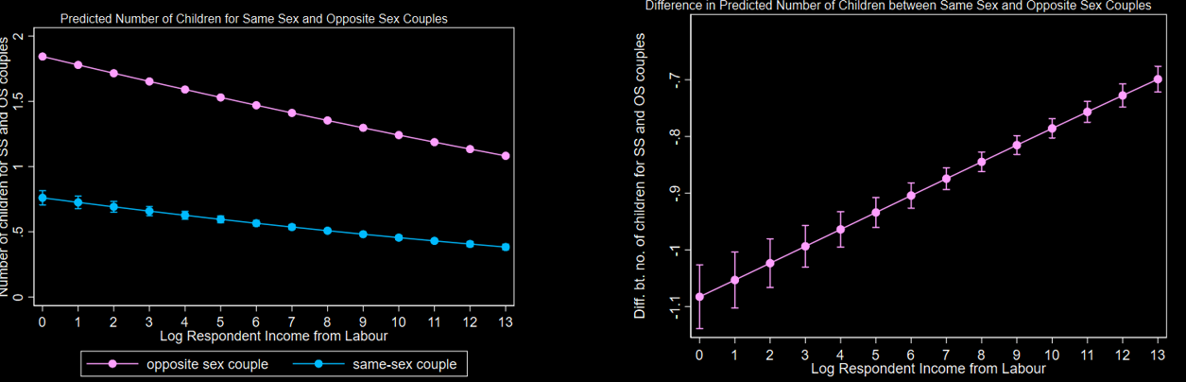

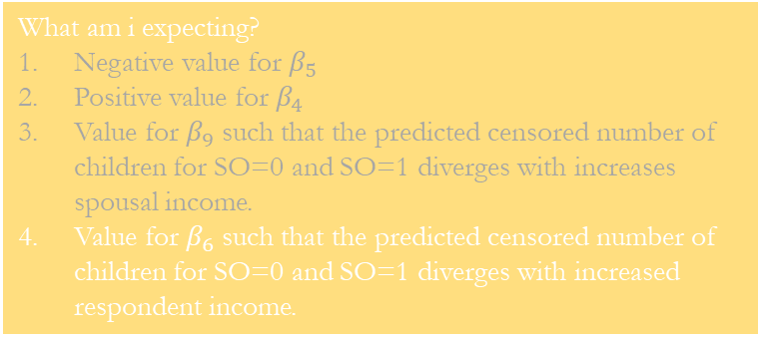
What am i expecting?
Negative value for $β_{5}$
Positive value for $β_{4}$
Value for $β_{9}$ such that the predicted censored number of children for SO=0 and SO=1 diverges with increases spousal income.
Value for $β_{6}$ such that the predicted censored number of children for SO=0 and SO=1 diverges with increased respondent income.
$${NChildren}_{i}= \\ β_{0}+β_{1}log{IncW}_{i}+β_{2}log{IncInv}_{i}+β_{3}{logIncWelf}_{i}+β_{4}{logIncSP}_{i}+β_{5}{SO}_{i}+β_{6}{\left(SO×logIncW \right)}_{i}+β_{7}{\left(SO×logIncInv \right)}_{i}+β_{8}\left(SO×logIncWelf \right)+β_{9}{\left(SO×logIncSP \right)}_{i}+ β_{k}X_{i}+e_{i}$$
Figure 9A: Predicted number of children for same sex and opposite sex couples.
Figure 9B: Difference in predicted number of children between same sex and opposite sex couple by logged respondent income from labour.
Notes:
and finally, here, we will be testing point 4
point 4 says that the censored number of children for opposite sex couples and same sex couples will converge as respondent income increases,
and that is what we see in the figure on the left. The figure on the left plots the predicted number of children for same sex and opposite sex couples at different values of logged spouse income.
we can see that the predicted number of children for both will converge as log respondent income increases we see this also in the figure on the right. The figure on the right again plots the difference in the predicted number of children between same sex and opposite sex couples.
As logged respondent income increases, the difference decreases.

Slide 8
Thank you for listening.

